Slide 1
Housing + Neighborhood Resource Summit
February 13th, 2018

Slide 2
4th Ward
Westside is the Best side

Slide 3
Welcome Neighbors
Mayor Andy Schor
City of Lansing
Superintendent Yvonne Caamal Canul Lansing School District

Slide 4
Will build a new, cleaner and efficient $500 million natural gas-fired
power plant at the Erikson Power Station facility in Delta Township.
Plant will complement its investment in renewable energy projects and
its energy efficiency programs.

Slide 5
Relocation of BWL’s Penn-Hazel Complex, including its warehouse and line, water, fleet and maintenance departments, to a new facility to be built at the RACER Trust site off of W. Saginaw St. and Stanley St. on Lansing’s west side.

Slide 6
BWL is in the first phase of installation of Smart Meters through its service territory. Approximately 5,200 meters have been installed so far. Installation will continue throughout the next 2-3 years.

Slide 7
Public Service
Andy Kilpatrick, Director

Slide 8
Streets
Lansing has approximately 410 miles of streets (107 major, 303 local), equating to about 930 lane miles of pavement to maintain.
Funding comes from Act 51 ($12.8 million), Federal sources ($1.5 million) and millage funding ($2 million) for a total of approximately $16.3 million.
To keep pace with the annual deterioration of the network, we need $20 to $25 million in funding for projects alone.

Slide 9
2017 Street repairs in 4th Ward
Mill and Overlay | 0.04 | Savoy Ct | $ 6,000
Mill and Overlay | 0.04 | Keegan Ct | $ 32,000
Mill and Overlay | 0.24 | Stanley St | $ 29,700
Mill and Overlay | 0.18 | N Walnut St | $ 102,200
Mill and Overlay | 0.18 | Turner St | $ 101,800
Mill and Overlay | 0.66 | W Willow St | $ 470,000
Ward 4 | 2.24 |  | $ 639,900
Total | 7.56 |  | $ 2,642,000

Slide 10
2018 planned street repairs
Spring we plan to complete another mile of local street repairs at a cost of approximately $75,000.
The paving of Pine Street will be completed in the spring of 2018 and Jolly Road between Pleasant Grove and Martin Luther King, Jr. Blvd. as well as Pennsylvania Avenue between Jolly Road and Cavanaugh Road will be repaved this summer.

Slide 11
Sidewalks
Network is over 600 miles. Assuming an average sidewalk life of 50 years, we need to replace 12 miles of sidewalk a year at a cost of approximately $2.5 million ($1.5 million City).
City funding for FY ’18 was $100,000. Sidewalk trip hazards are now being remediated through cutting ($120k), which is much more cost effective than replacing the sidewalk.
Received Safe Routes to School grant, sidewalk ramps at over 60 intersections were replaced around four schools (Wards 1 and 3), which will be followed up with a sidewalk repair project.

Slide 12
Sewer
This spring we are starting sewer separation projects again, after a break of close to 10 years. Located primarily in the Moores Park neighborhood, but also includes work on MLK Jr. Blvd. and Mt. Hope Avenue.
Current project is up to $16 million and is a two year project. Work is scheduled to start in April. The projects will continue, at a minimum of one project per year, for the next 15 years.

Slide 14
City of Lansing Parks and Recreation
Brett Kaschinske, Director

Slide 15
Notes:
We are currently funded for – 1st 3 received trust fund recommendation from the board to the legislature – they need to approve and send to governor – generally rubber stamp
Scored 380 – well above the cut line
Ingham trails mileage will match these three grants to pay for the projects
All Lansing in green – expect to be funded – brett there at the meeting to make sure tonight

Slide 16
Notes:
One pictured will be like the one at City Market – anticipated late 2018
City market ability to dock boats – others will not

Slide 17
Notes:
Between Moores and Riverpoint – GM and BWL Eckert station meet – scheduled to be repaired in 2018

Slide 18
Notes:
All along the river this year. Majority Potter Park zoo east to Clippert

Slide 19
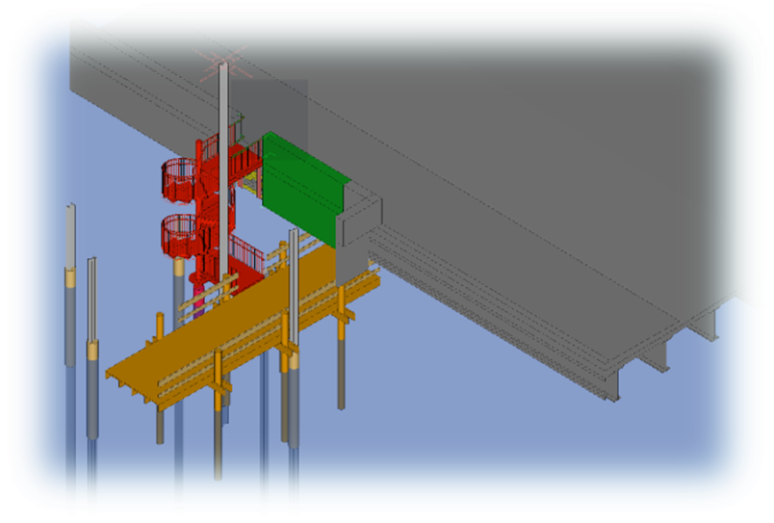
Notes:
South (pictured) and north are going to be repaired
Both galvanized metal
North adding light pole to replace small lights that get damaged
These are in conjunction with the MDOT work on the MI avenue bridge
Completion – Sept 2018

Slide 20
Notes:
With Community Foundation – fundraising/planning for placemaking along the riverfront
Priority groups: Bridge rehab, bank stabilization, pavement
MP Pavillion $100,000 & Wilson path $400,000– we have not set this years Capital Improvement Project list – these projects are heavily consideration
Talk about Letts
Quentin Park project – improving baseball fields
Cambridge road extention – looking to put in a DNR grant for that

Slide 24
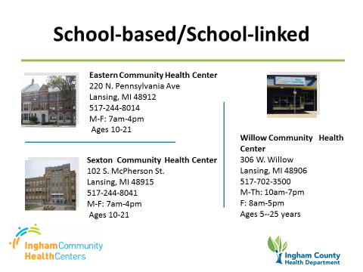

Slide 25
Resources
Thank you!

